Slide 1
Applied HCI
COMP719
Week 4
Interaction Frameworks
Key HCI concepts

Slide 2
Learning outcomes
Explain the terms of interaction
Describe Norman’s execution-evaluation interaction model
Describe the Interaction framework (Abowd and Beale) and how it differs from Norman’s model
Describe Wellington’s theory of mapping
Explain other key HCI concepts: usability, consistency, closure, visibility, feedback;

Slide 3
What is Human - Computer Interaction?
The communication between the user and the computer system
The translation between what the user wants and what the system does
Notes:
Talking about the interaction.. Communication going on ..
The program the interface..

Slide 4
The terms of Interaction:
Goals – the desired output from a performed task (what the user wants to achieve)
Domain – an area of expertise and knowledge in some real-world activity (Graphic design, process control, etc.)
  A domain consists of concepts that highlight its important aspects
  Example: Graphic design - geometric shapes, drawing surface, drawing tools
Tasks – operations to manipulate the concepts of a domain

Slide 5
The terms of Interaction:
Intention – a specific action required to meet the goal
Task analysis – identification of the problem space for the user in terms of the goals, domain, tasks and intentions.
Notes:
Task analysis is looking at all the above things..
A consultant might do a task analysis.. To figure out what you want to achieves in company.. Systems.. Etc..

Slide 6
The terms of Interaction:
System and User – described by means of language that can express concepts relevant in the domain of the application
Core language – this is the System’s language and it describes computational attributes of the domain relevant to the System state
Task language – this is the User’s language and it describes psychological attributes of the domain relevant to the User state.
Notes:
Core language.. Computational part of it.
Task languande..Use language ..natural language (do this now)

Slide 7

Models of Interaction
Donald Norman’s Model of Interaction
  the most influential in HCI
  close to intuitive understanding
Norman’s model has been extended by Gregory Abowd and Russel Beale (1991)

Slide 8
Donald Norman’s Model of interaction
There are two major phases:
  Execution (steps 1-4) and
  Evaluation (steps 5-7).
Each stage is an activity of the user.

Slide 9
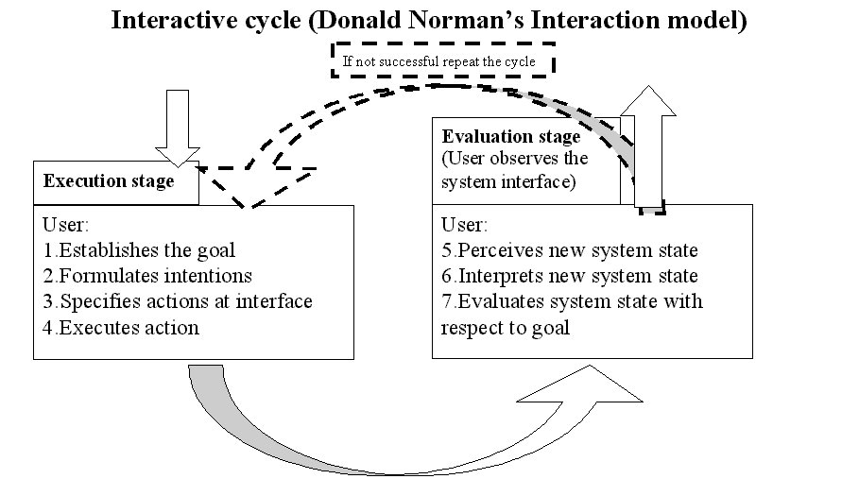

Slide 10
Some systems are harder to use, some others are easier…
Gulf of Execution – the difference between the intentions and the allowable actions
  user’s formulation of actions may be different to those actions allowed by the system (task language vs core language)
• Gulf of Evaluation – the amount of effort that the person must make to interpret the physical state of the system
  user’s expectation of the changed system state may be different to the actual presentation of this state
Notes:
GUE 1.. U know what you want to do..but u don’t know how to do it
GUE2.. U cant fugure out what to do..

Slide 11
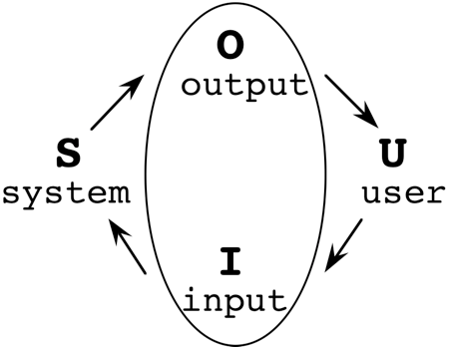
Abowd and Beale
Interaction framework
Their Interaction framework has 4 parts:
• User • System
• Input • Output

Slide 12
Abowd and Beale
Interaction framework
There are 4 steps in the interactive cycle:
Presentation
Observation
Performance
Articulation

Slide 13
Abowd and Beale
Interaction framework
Each part of the framework has its own unique language.
Evaluation phase
Output Language
Presentation
Observation
Core language
Task language
Performance
Articulation
Execution phase
Input Language

Slide 14
Abowd and Beale framework
Interaction necessitates translation between languages;
Problems in interaction occur when translation between one language and the next is difficult or impossible.

Slide 15
Interaction framework
Why have an interaction framework?
  Identifies all the major components involved in interaction
  Models and frameworks are a means to judge the overall usability of an entire interactive system
  Allows comparative assessment of systems
It is not restricted to electronic computer systems
Notes:
Figure out where in the framework has the problem..
Allows to identify dufference..
Restaurant.. Diner user.. Restaurant is the system
Fancy restaurant.. Don’t understand the menu.. Chinese go to france menu..
Output language is the menu
Task language is the user language
Input is the order user
Core is the behind language.. The chef…
Interface.. Waiter..

Slide 16
Key HCI concept: Usability
‘A measure of the ease with which a system can be learned or used, its safety, effectiveness and efficiency, and the attitude of its users towards it’ (J.Preece et al, Human Computer Interaction, 1995)
Emotions and usability – “Emotional design” by D. Norman (see http://www.jnd.org/ED_Draft/CH01.pdf )
“User-friendly” – an overused cliché
Notes:
Can touch on gameflow theory…

Slide 17
A Theory of Mapping
A Theory of Mapping, a work in progress, probably shifting to more on Affordance, but with some key similiarities
Underlying theories
  Social Constructionism (Berger and Luckman)
  Affordance (Norman, Gibson, Hartman)

Slide 18
Key Concepts
Cognitive Load
Culture
Context of use

Slide 19

Norman’s mapping
A technical term meaning the relationship between two things, in this case between the controls and their movements and the results in the world.
back right
front left
back left
front right

Slide 20
Affordance
Any visual object has intrinsic properties, that suggest to us how the object can be manipulated. The appearance of the object stimulates a familiarity with its behaviour. ‘Perceived affordance’-how a particular user perceives the affordances.
Notes:
Preceived on how things are done.. Tools has rubber grips..mug got a handle..
Door has a D handle.. U are suppose to pull..eventhough you have to push

Slide 21
The management of British rail decided to use toughened glass for a partition on one of their platforms. It was smashed twice by vandals in the area and was eventually replaced with plywood. Although not stronger than the toughened glass it remained intact although there were other problems. What were the problems?
What kind of actions did the glass afford and what did the plywood afford?
Notes:
Plywood.. Grafitty it..

Slide 22
Context To Culture Continuum
Affordance can be thought of as being more culturally or more contextually informed.
These ‘ends’ of the continuum are not mutually exclusive, both types of affordance influence our perception of how we interact with an artefact.

Slide 23
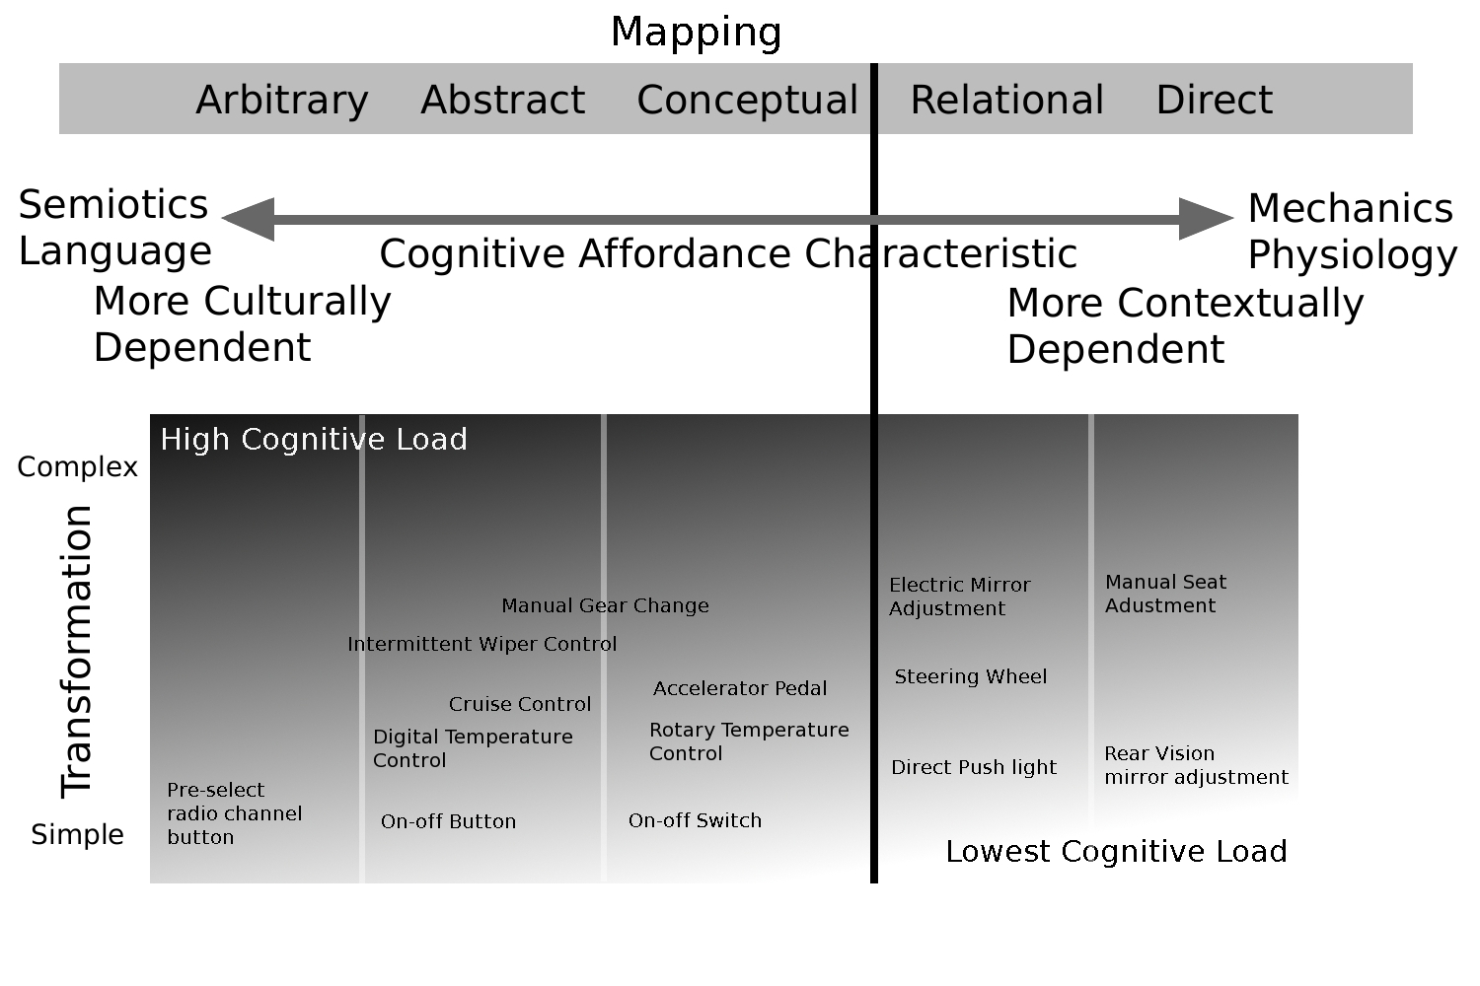
Wellington, 2012

Slide 24

Notes:
This relates to mapping, in that the forward controls operate the base of the excavator. If the turntable is oriented in a different direction then the mapping is incorrect. This then has inconsistent mapping.

Slide 25
Other Key HCI concepts
Visibility
Consistency
Closure
Feedback
Notes:
Mapping is a technical term meaning the relationship between two things, in this case between the controls and their movements and the results in the world.
Any visual object has intrinsic properties, or affordances, that suggest to us how the object can be manipulated. The appearance of the object stimulates a familiarity with its behaviour. ‘Perceived affordance’-how a particular user perceives the affordances.
Visibility – the correct parts must be visible and they must convey the correct message.
Controls need to be visible, with good mapping with their effects. Their design should suggest (ie. afford) their functionality.
Consistency - agreement or harmony of parts or features to one another or a whole; (degree of firmness)
Closure - when people complete some goal, they experience closure. This means that they have a feeling of completeness and go on to the next thing. Closure has implications both on perception and actions. It is why in the mouse positioning task, the user's eye may stray from the target as soon as the target is perceived as 'hit'. In addition, the user may begin some of the actions for the next task, while certain automatic actions terminating the last task are still going on.
Feedback – sending back to the user information about what action has actually been done [and] what result has been accomplished

Slide 26

What is this?

Slide 27

…and this?
hmm

Slide 28
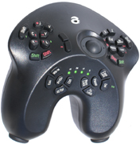
… and this?

Slide 29
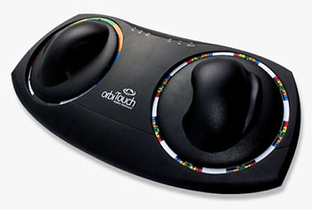
…and finally?

Slide 30
Visibility
Controls need to be designed so that they:
  are visible;
  have good mapping with their effects;
  suggest (i.e. afford) their functionality;
  Controls must convey the correct message
Notes:
Colour and perception..
Controls.. Must convey the right message esp international cause u might not be able to convey the right message because of language..

Slide 31
Visibility
There is usually no single best design alternative.
For example, a graphical interface may involve a set of actions that the user can:
  invoke by use of the mouse and the designer must decide whether to present each action as a 'button' on the screen, which is always visible (max operation visibility)
  hide all of the actions in a menu which must be explicitly invoked before an action can be chosen (takes up less screen space)
  (Alan Dix et al, Human computer Interaction, 1998)

Slide 32
Consistency
Agreement or harmony of parts or features to one another or to a whole

Slide 33
Closure
When people complete some goal, they experience closure, i.e. a feeling of completeness
Closure has implications both on perception and actions.
Notes:
Early automated teller machines gave the customers the money before returning their cards. This led to many customers leaving their cards behind. This was despite on-screen messages telling them to wait.
The user's principal goal is to get money; when that goal is satisfied, the user does not complete or close the various subtasks which still remain open
(Alan Dix et al, Human computer Interaction, 1998)
It’s important to build closure into systems

Slide 34
Feedback
Sending back to the user information about what action has actually been done [and] what result has been accomplished

Slide 35
References
Dix, A. et al (1998) Human Computer Interaction, 2nd ed., Prentice Hall Europe.
Shneiderman, B. (1998) Designing the user interface, 3rd ed., Addison Wesley.
Wellington, R. (2016) Marshall McLuhan, Affordance, Mapping, and Human Computer Interaction in Interactive Media, in Information Systems and Management in Media and Entertainment Industries,p133-148, Springer
Wellington, R. (2015) Context to Culture for Gamification HCI Requirements: Familiarity and Enculturement,in Gamification in Education and Business, p151-163, Springer

